Slide 1
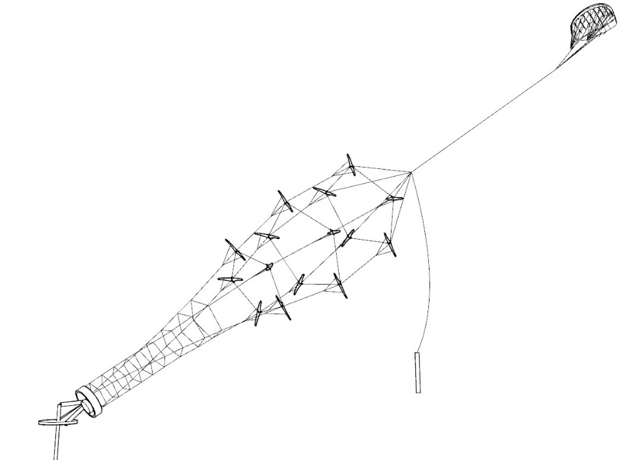
Sub 1kW Kite Turbine Parts
The following parts descriptions are relevant to the <1kW mechanically autonomous Kite Turbines developed at Windswept and Interesting Ltd.
These details are released CC-BY-SA-4.0
TRL ratings are given in the context of a fully autonomous product safe enough to release to the general public as a product.
This turbine design - is not a safe product. You would only replicate this assuming all risk and responsibility
Lift Kite
Turbine Head
Turbine
Transmission
Backline Handling
Ground Station

Slide 2

Kite Turbine sub-systems
Lift Kite
Turbine Head
Turbine
Transmission
Backline Handling
Ground Station

Slide 3

Lift Kite
Lift Kite
State TRL 3 Some basic concept prototypes and models have had an initial field trial Others are still only conceptual. Analogous products exist elsewhere in AWES.
Turbine Head
Turbine
Transmission
Backline Handling
Ground Station
The Lift Kite was always hand launched and landed. - Automating this functionality may help your project.
The Lift kite was mostly a mechanically autonomous HQ KAP lift foil. - Automating this may help your project.
Short tests of battery powered RC servo bridle winding steering systems had run successfully.
You might consider a flight controller, onboard charging, communications, rtk GPS and novel steering.
Steering has run on basic IMU sensing with bluetooth control - You will want to update steering algorithms, Add field wifi and operational mode awareness for reliability and safety.
Lift Kite position was occasionally limited within the prevailing wind with two additional lightweight steering anchor lines tied to steering bridles - You may want to address methods of full azimuth operation and bank angle control to enable operation throughout the wind window and in changing wind conditions.

Slide 4

Turbine Head
Lift Kite
Turbine Head
State TRL 3
The turbine head has been constructed from adapted skate wheel and axle configurations. No smarts included.
The system has run both ways - with simple through axles holding the turbine tip whilst the rim held the top lift line steady and with the turbine on the rim and the axle steadied by the lift and backline. This second configuration is preferred.
No attitude, speed, power, monitoring, communications, control or autonomous connection has yet been functionally implemented
Turbine
Transmission
Backline Handling
Ground Station
You may want to augment a turbine head to be capable of communicating rtk gps position and line tension data to aid ground station alignment and backline handling. The turbine head is attached and detached from the lift-line/ back-line whilst in the launch and land stages.

Slide 5
Backline Handling
Lift Kite
State TRL 3
The Backline Handling has been limited to manual handling operations to date.
The backline has been a partially bungeed line, anchored to hold the turbine head lower and downwind.
On occasion we used spread twin lines from the ground to the turbine head & lift line connection point - to limit azimuth drift under an unsteady lifter.
A straight line ground “horsetrack” backline anchor system has been trialled to allow azimuth tracking whilst keeping backline tension.
The backline has been tested with bungee to remove the potential for slack to wrap around in the case of torque transfer to the lift line.
The backline has been manually tested for turbine stalling. In turbine stalling the backline is pulled around the field to pull the turbine head to a position 90 deg to the inflow of wind… Thus stalling the turbine.
Turbine Head
Turbine
Transmission
Ground Station
Backline Handling

Slide 6

Turbine
Lift Kite
State TRL 4
Several “blade” kites set around a rigidised ring form a turbine rotor.
Our early turbines mostly exploited the cheap and easy fix nature of ram air kites attached to varied forms of ring support system.
A shift in design to rigidised foam profile wings resulted in the best AWES Power/Weight test efficiency to date.
A first description of the turbine system performance was achieved through a PhD collaboration with University of Strathclyde.
Turbine Head
Turbine
Transmission
Backline Handling
Ground Station
Turbine can be modularly constructed to be able to be flown alone or stacked together.
A turbine rotor can connect to another lower turbine rotor, or to the transmission.

Slide 7

Transmission
Lift Kite
State TRL 4
The unique dynamic properties of Tensile Rotary Power Transmission (TRPT) were described in Oliver Tulloch’s PhD.
TRPT is a new class of Airborne Wind Energy power transmission.
Several variations of transmission have been tested and characterised at W&I.
W&I prefer the more dynamic polygon to polygon TRPT in preference to rod to crossed rod style TRPT (see tuddel power someawe.org) due to handling and efficiency benefits
Turbine Head
Turbine
Transmission
Ground Station
Backline Handling
TRPT can be modularly constructed.
Transmission line tabs attach transmission lines to the polygon nodes.

Slide 8

Ground Station
Lift Kite
Turbine Head
State TRL 3
The Ground Stations had passive azimuth alignment with elevation tracking predominantly being set pre-flight, manually. It is best to set this firmly before launch as the dynamic interaction of generation can easily impact axial alignment. This assumes you will hold the turbine head in a relatively fixed position.
The generation system used a VESC for torque control using FOC on a 500W rated BLDC motor. Regen went into 2 x e-bike batteries
Control commands came from a basic human interface combined in an algorithm with data from anemometer, onboard tension sensing and the speed controller.
Make sure your ground station is securely fixed to a very oversized anchor system.
Turbine
Transmission
Backline Handling
Ground Station

